Slide 1

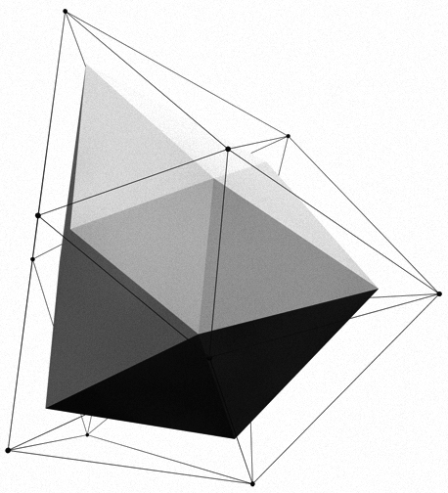


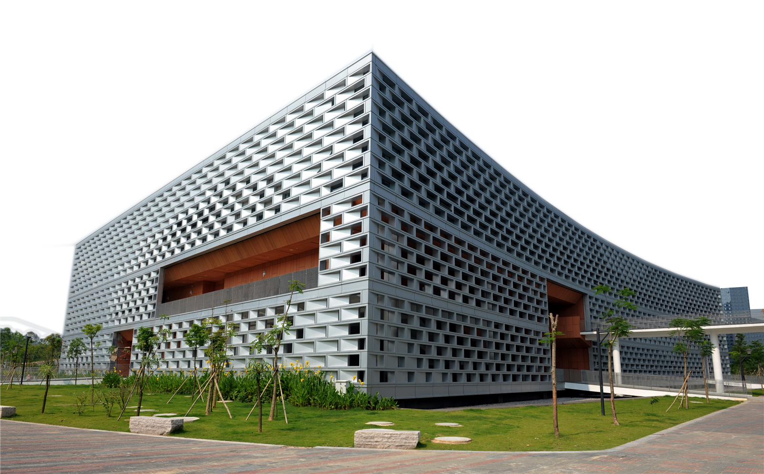
SUSTechMajiang
卞证 向昕昊 徐天元 林傲 孙斌贤

Slide 2
Motivation
With the development of the number of students in SUSTech, there is an urgent needs to develop more kinds of recreational activities for SUSTech students to relax and have fun.
If there is a recreation game where the background and some game elements comes from SUSTech, not only can it enrich students’ campus life, but also it enhance students’ campus identity pretty well.

Slide 3


The Product We will make
Our group is devoted to develop an Online Mahjong game with SUSTech elements and try to fulfil this mission.
An online game combined with the basic Mahjong rules and SUSTech background.
Download the client-side (.exe file) first and play with other users on the platform

Slide 4
Target customers of our products
S
faculties
F
students
Etc.
E
I
interested in SUSTech
Since SUSTech is a rapidly developing university with increasing ranking and popularity, it should have huge potential market.

Slide 5
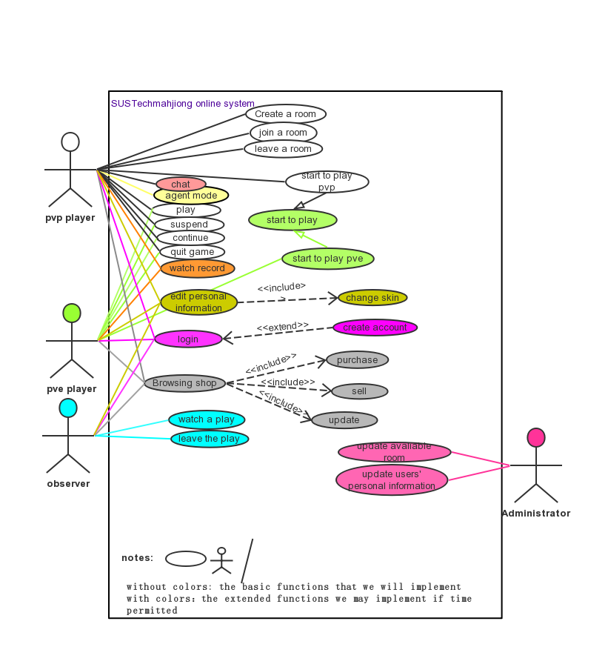
Case diagram
Product feature description

Slide 6
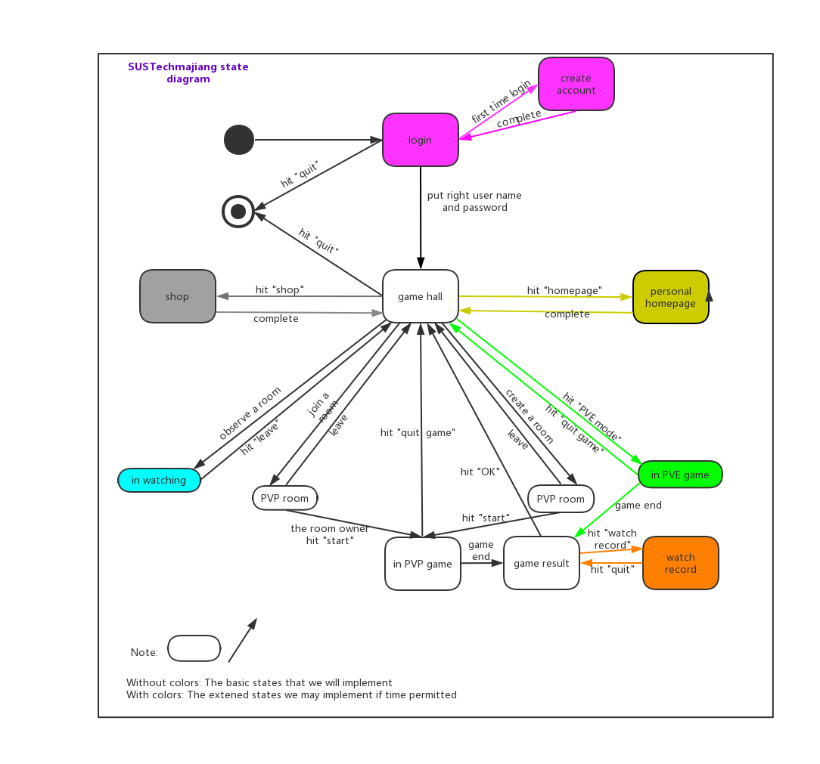
State diagram

Slide 7
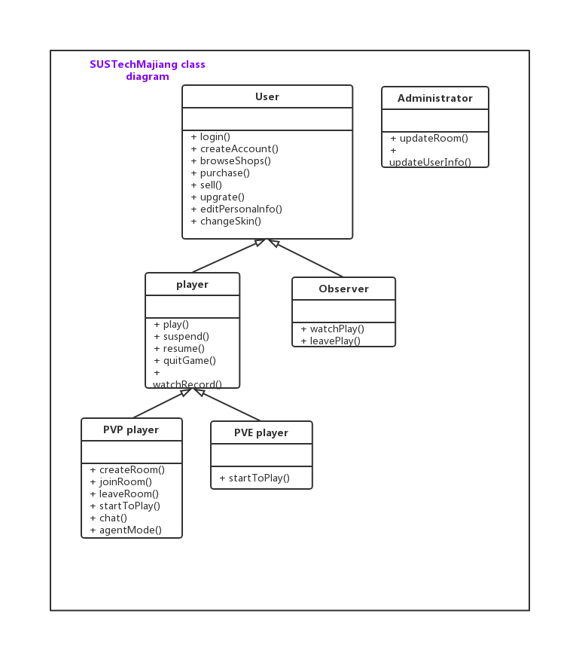
Class diagram

Slide 8
Core Competence of our Products
How to combine the mahjong rules with SUSTech elements
Big events we will implement in the project:
(1) All the background imagines of the game (game hall, front and back of cards, buttons, etc.) will be in SUSTech element.
(2) Our background music will combine mahjong and SUSTech style.
(3) Besides the 144 basic cards in mahjong, we have 8 extra cards as special function cards.

Slide 9
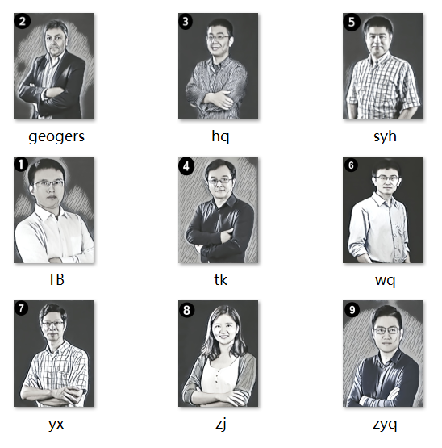
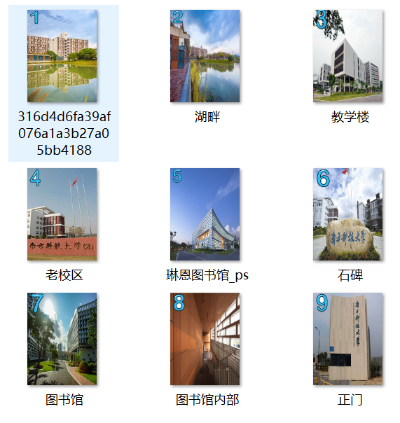
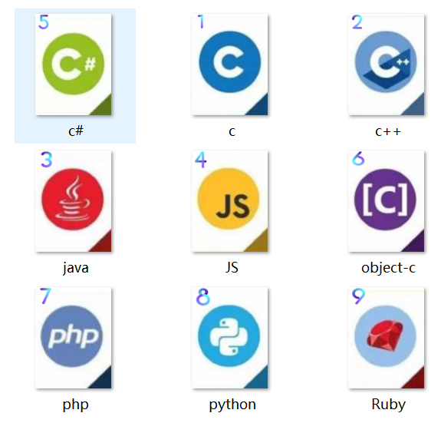

Slide 10
Each team member’s responsibility
林傲
Project Master planning
Design the rules of the game
Communicator (I/O)
(1) Keep in touch with “customers”
(2) Collect the latest information about the project and do manage (UML).
(3 )Write project report and do presentation
(4) Help implement the code
向昕昊
卞证
Chief programmer
Implement the code
徐天元
孙斌贤
Project Deputy Planning and Associated programmer
(1) Solving technical problems
(2) Help Implement the code
Art Designer
(1) Provide art resource
(2) Make cards with SUSTech element
(3) Design UI in the anaphase

Slide 11

Timeline
preparatory phase:
(before the opening report 2019.10.9)
game rule
Art materials
learn APIs
1
prophase:
(before 11.11)
2
game logic
combine
Implement
so that the whole game can run.
anaphase:
(before 12.11）
3
Testing and maintaining

Slide 12

Difficulties have been overcome
Network framework
Communication between Client and server
Sticky package, half package
Interactive between server and database
Send complete data at the end of commu

Slide 13
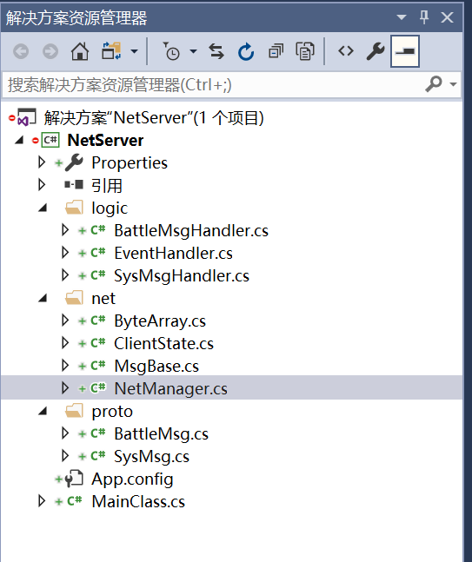
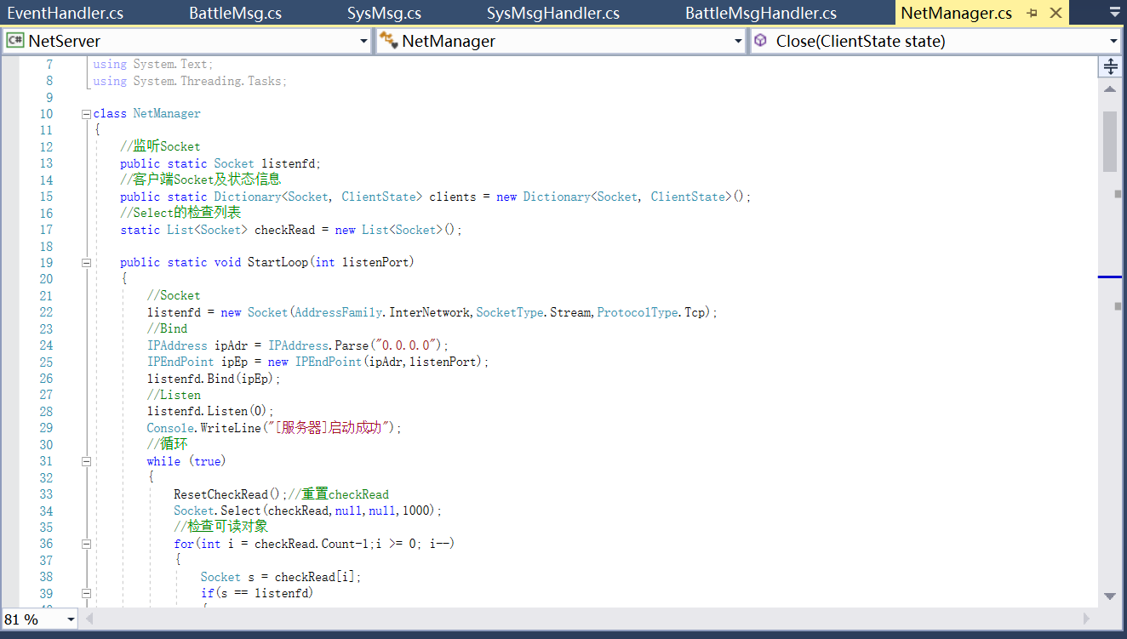
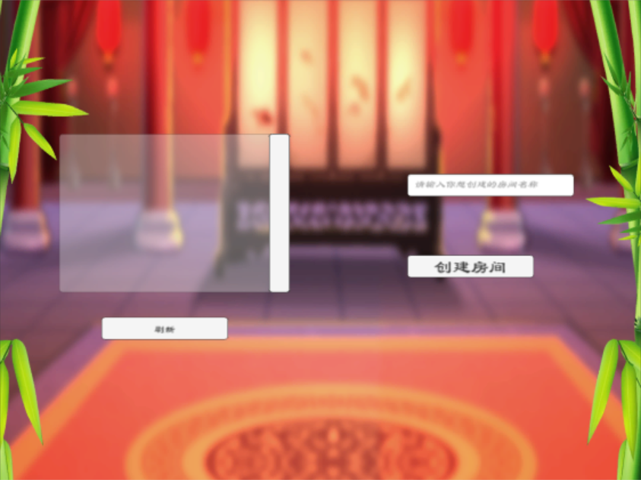
Server-side code screenshot

Slide 14
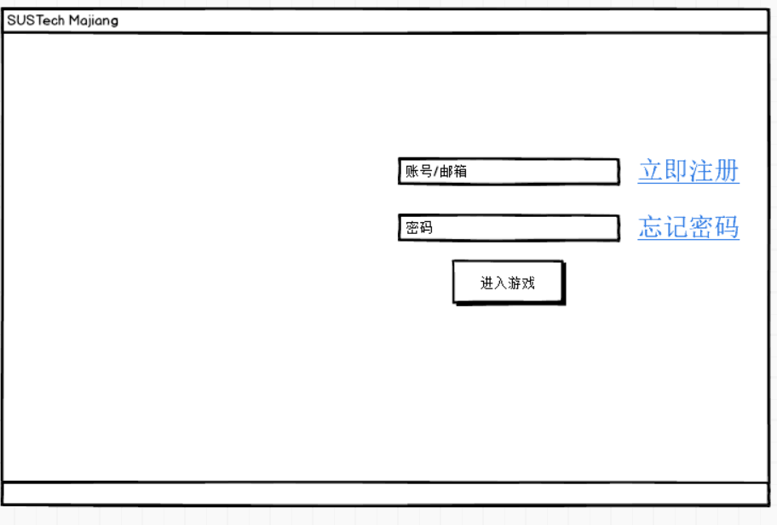
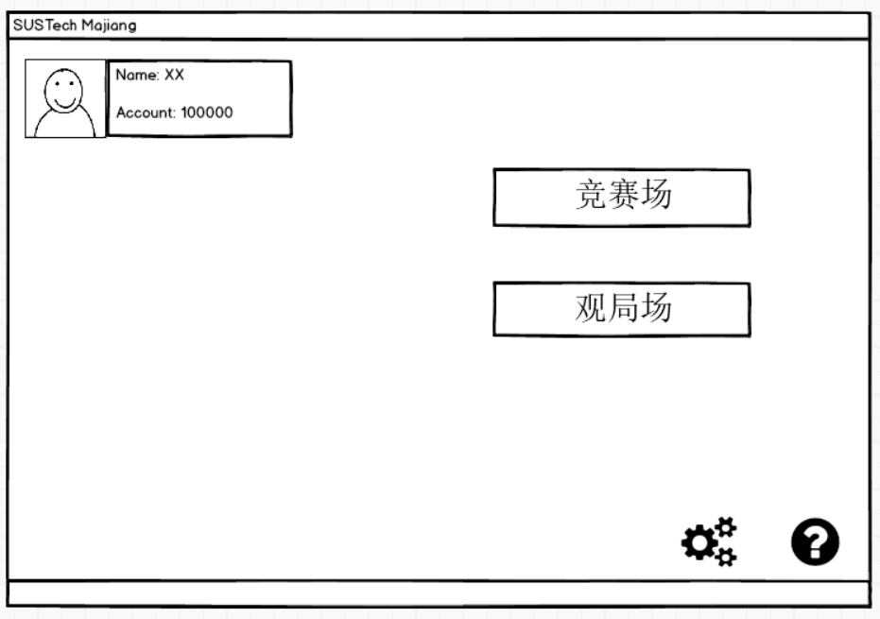
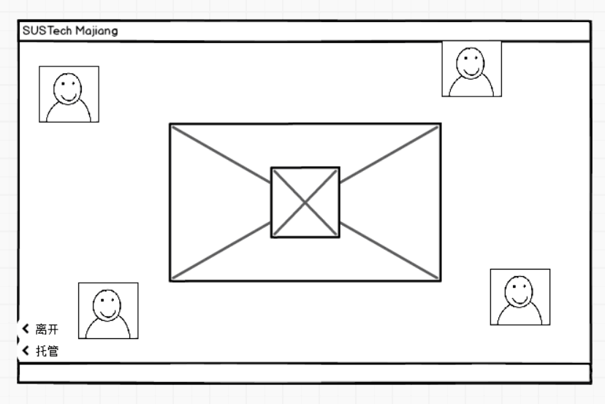
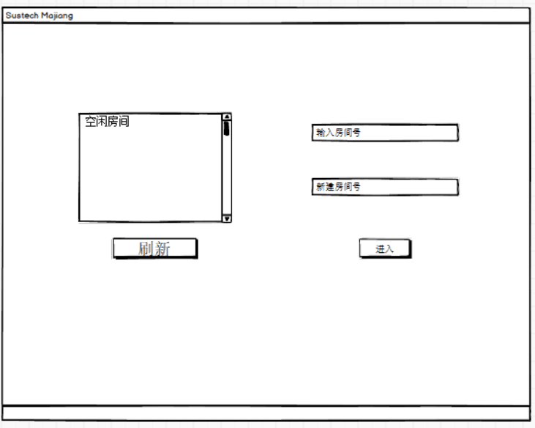

Slide 15
Some functions that can extend
develop PVE mahjong game
develop the account system
develop shop system
develop section level system
develop skin system
develop “agent mode” in pvp play
develop “watch record” after a play
develop “chat” in pvp play
develop “observer” mode
XXX

Slide 16

APIs we use
.Net socket
UGUI
Unity

Slide 17
Feasibility
Things that may lead us to fail :
Lack of familiarity with APIs
Unable to deliver on performance
Cost excessive
Too many features (prioritize)
Third party APIs/service may not be reliable

Slide 18
However, we are still confident that we can complete the project, for the reason that:
1.Have clear division of every member’s responsibility and scientific management system.
2. Have completed in time and have master the basic knowledge of the tools and APIs we will use.
3.There are no much cost, maybe the only cost is our time!
4.We will first develop the basic version and make sure it can run well, then will we consider developing other extensive function
5. All the APIs we used are sophisticated and legal software

Slide 19
References
中国麻将竞赛规则 http://www.xqbase.com/other/mahjongg.htm
麻将基本术语中英文对照
http://www.xqbase.com/other/mahjongg_english.htm

Slide 20
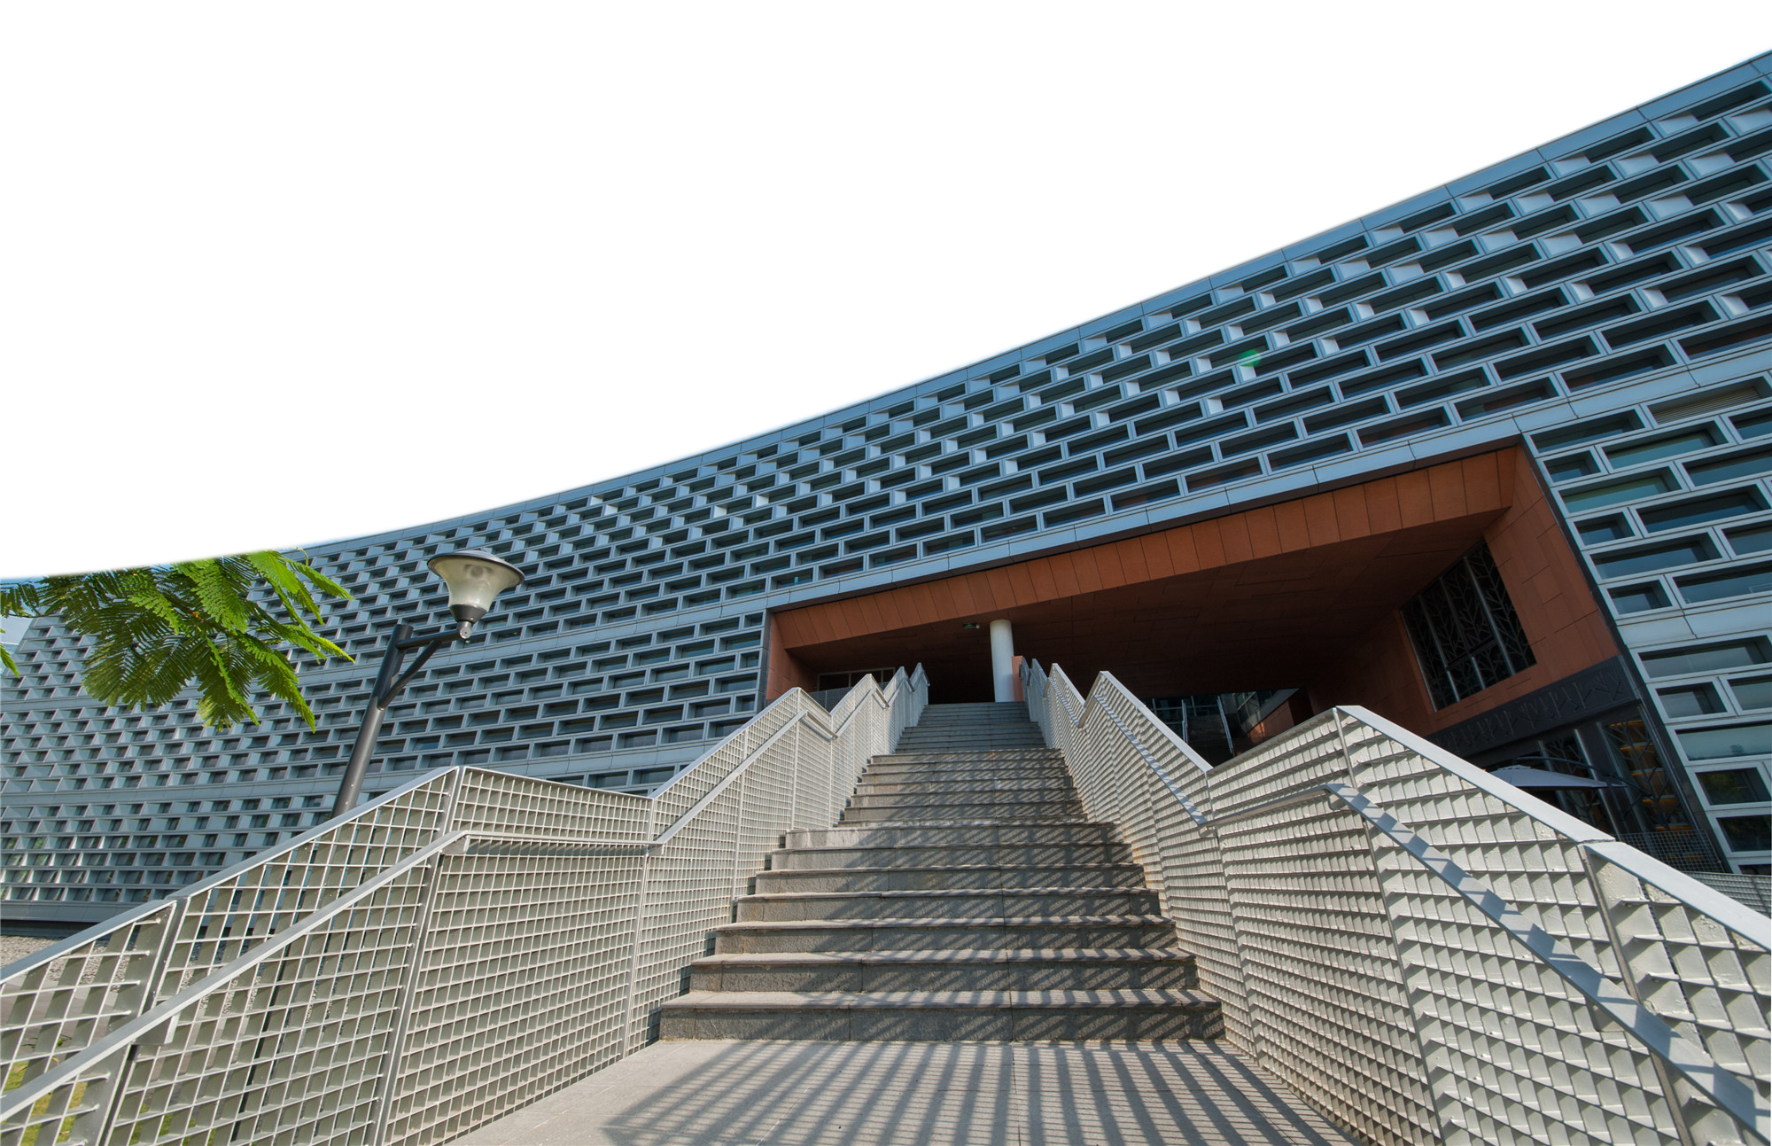
THANK YOU
卞证 向昕昊 徐天元 林傲 孙斌贤

